Slide 1
Building a Question Answering Application
By Aditya Wankhade

Slide 2
Table of Contents
Introduction
Macaw
Our QnA model
Conclusion
Extractive Model
BM25
Generative Model

Slide 3
Introduction
Question Answering models are used to automate the response to frequently asked questions by using a knowledge base as context
There are different QA variants based on the inputs and outputs:
Extractive QA: The model extracts the answer from a context. The context here could be a provided text, a table or even HTML! This is usually solved with BERT-like models.
Open Generative QA: The model generates free text directly based on the context. You can learn more about the Text Generation task in its page.
Closed Generative QA: In this case, no context is provided. The answer is completely generated by a model.

Slide 4
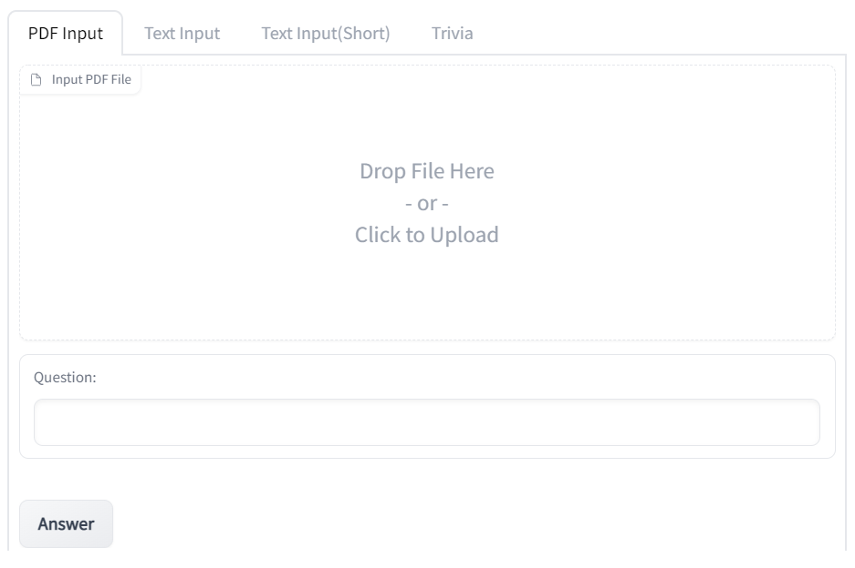
Our QnA model
Our QA model interface has been built using the Gradio app.The model tries to explore both Extractive and Generative QnA
The extractive part accepts either a PDF or a text paragraph as the input knowledge base
The generative part tries to answer general knowledge trivia questions using free text generated from the model.

Slide 5
Extractive Model
One can directly use a hugging face transformer model along with the corresponding tokenizer to create a Question Answering pipeline.One of the disadvantages of the approach is that a pipeline hides or abstracts a lot of the underlying information.
Also the output of such a pipeline is restricted to a fewer number of words even for questions where a bit more clarity might be required in the answer.
An approach to this problem can be to use a passage ranking model whereby different documents can be ranked on the basis of their relevance to the query and correspondingly passed to the QA model to find the best possible answer

Slide 6
Extractive Model
The main steps used in our Extractive QA approach are summarized as follows:
Firstly the PDF file is extracted with the help of a PDF miner and converted into a text corpus.
Next the text corpus is tokenized and passed to the BM25 Okapi algorithm
The retriever function then uses this to retrieve the documents with the most relevance to the query
These documents are finally passed to our QA pipeline and the answers are then ranked according to their respective scores
So we finally get our answer along with the document/passage the answer was a part of giving our answer more clarity as opposed to single line answers.

Slide 7
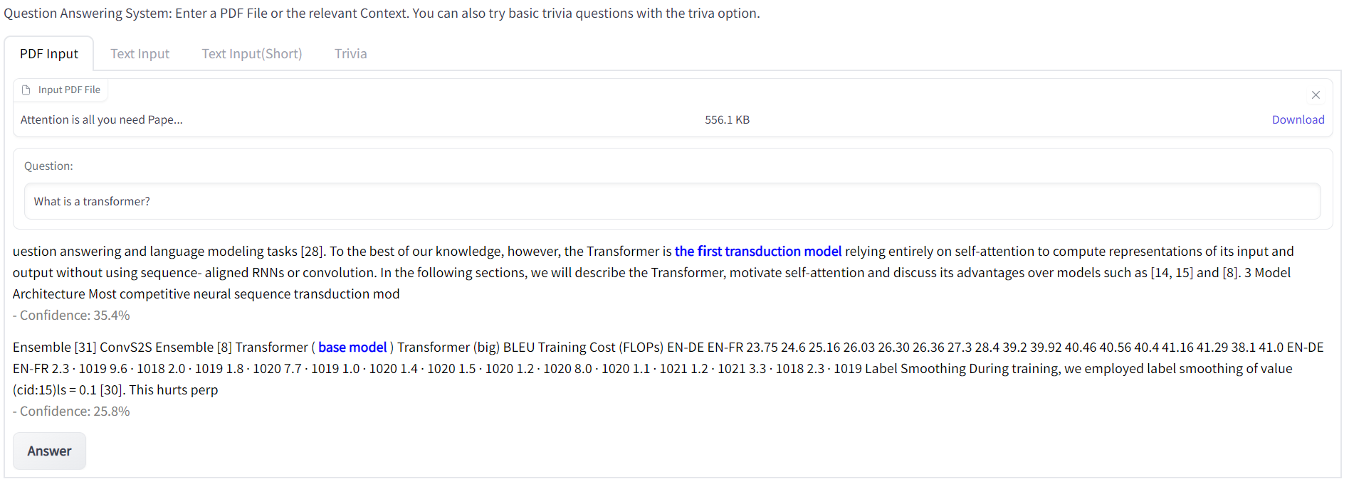
QA Model with PDF Input
Here the research paper ‘Attention is all you need’ is used as an input

Slide 8
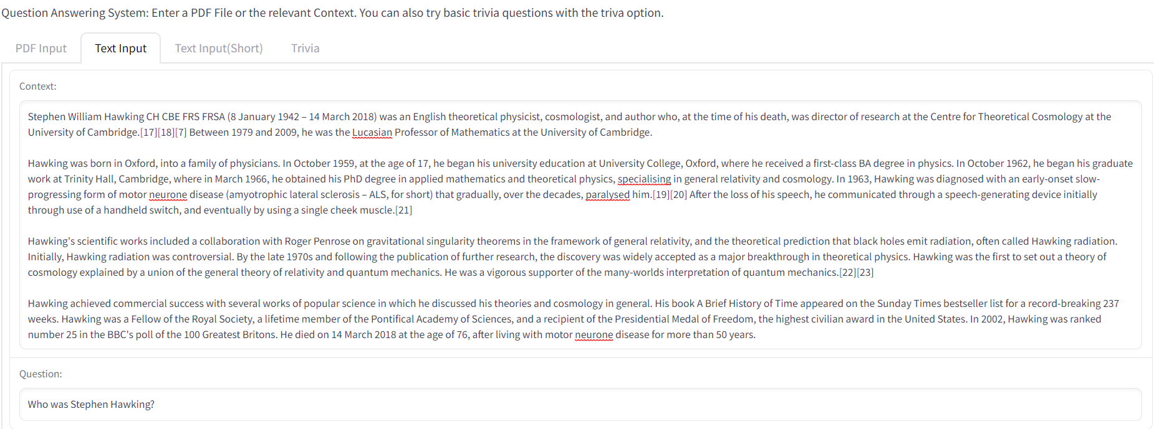
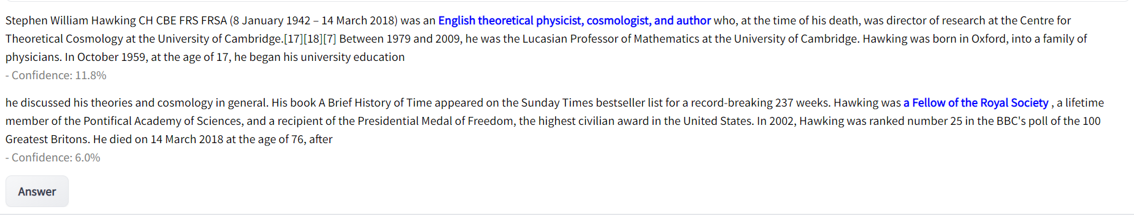
QA Model with Text Input

Slide 9
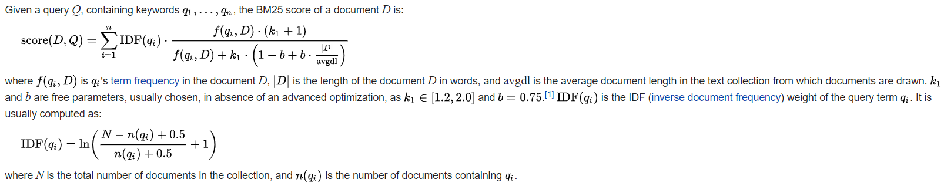
BM25
BM25 is a bag-of-words retrieval function that ranks a set of documents based on the query terms appearing in each document, regardless of their proximity within the document.BM25 and it’s newer variants represent TF-IDF like retrieval functions used in document retrieval.It’s mathematical formulation is given as follows:

Slide 10
Generative Model
Macaw (Multi-angle c(q)uestion answering) is a ready-to-use model capable of general question answering, showing robustness outside the domains it was trained on. It has been trained in "multi-angle" fashion, which means it can handle a flexible set of input and output "slots" (like question, answer, explanation)
Macaw was built on top of T5 and comes in different sizes: macaw-11b, macaw-3b, and macaw-large, as well as an answer-focused version featured on various leaderboards: macaw-answer-11b

Slide 11
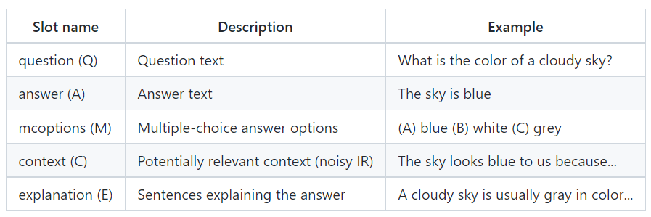
Macaw
An angle is a specific set of input/output slots, for instance QM->AE is the task of producing answer and explanation, given a question and multiple-choice options. Macaw is trained on a wide variety of angles and handles unseen angles as well, one exception is that the context (C) only appears as an input slot in the training data.

Slide 12
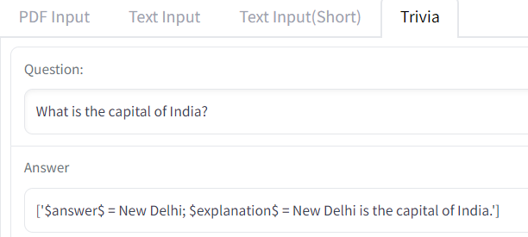
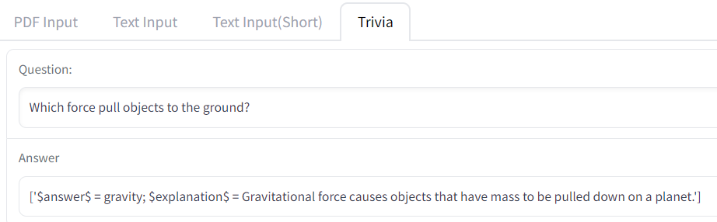
QA Trivia using Macaw
Here are some examples of the model trying to answer general knowledge trivia questions
The model works best for commonly known scientific questions and fails for questions that go beyond it’s knowledge domain
These results are obtained using macaw-large the smallest model and better results can be obtained using larger models like macaw-11b but which also takes greater amount of memory.

Slide 13
Conclusion
Both Extractive and Generative offer different strengths and use cases, and also have their own limitations.
While an Extractive model works well for accurately answering questions on it’s knowledge base, quite often the knowledge base might not be exhaustive enough hence hindering the model’s answering capabilities.
A Generative model on the other hand has the advantage of being able to answer questions from a much wider knowledge base. However the quality of answers may not always be good enough.Here our Generative QA can show vast improvement if a macaw-11b model is used, the only limitation being the lack of available resources to download such a huge model

Slide 14

Thank you!

